Slide 1
Access Control Convergence: Challenges and Opportunities
Ravi Sandhu Executive Director and Chief Scientist Professor of Computer Science Lutcher Brown Chair in Cyber Security
International Conference on Information Systems Security December 2020
ravi.sandhu@utsa.edu www.ics.utsa.edu www.profsandhu.com

Slide 2
Convergent Research
Disciplinary
INCREASED
Collaboration
Interaction
New paradigms
New concepts
New language
New disciplines
Multi-Disciplinary
Inter-Disciplinary
Convergent

Slide 3
Convergent Research
Disciplinary
INCREASED
Collaboration
Interaction
New paradigms
New concepts
New language
New disciplines
Multi-Disciplinary
Inter-Disciplinary
NAP Report 2005
Convergent
NAP Report 2014
NAP = National Academies Press

Slide 4
Convergent Research
Disciplinary
INCREASED
Collaboration
Interaction
New paradigms
New concepts
New language
New disciplines
Multi-Disciplinary
Inter-Disciplinary
Cross-Disciplinary
Convergent
Trans-Disciplinary

Slide 5
Convergent Research
Disciplinary
INCREASED
Collaboration
Interaction
New paradigms
New concepts
New language
New disciplines
Multi-Disciplinary
Inter-Disciplinary
Convergent
DRIVERS
-- Deep scientific questions
-- Pressing societal needs

Slide 6
Cyber Security Research Convergence
Objectives
POLICY
ATTACKS
Enable
What?
Why?
Respond
Enforce
Defend
PROTECT
How?
DETECT
Application
Context
Mechanisms
Complement

Slide 7
Cyber Security Research Convergence
Objectives
POLICY
ATTACKS
Enable
What?
Why?
Respond
Deep scientific questions:
-- We have no clue how to do this
Pressing societal need:
-- Cyber security is hugely important and broken
-- Cyber security researchers lack incentive to converge
Enforce
Defend
PROTECT
How?
DETECT
Application
Context
Mechanisms
Complement

Slide 8
Access Control Research Convergence
ABAC
ReBAC
RBAC
…
DAC
MAC
Convergent Access Control (CAC)
Access Control Policy Models
Access Control Enforcement Models
Application
Context

Slide 9
Access Control Research Convergence
ABAC
ReBAC
RBAC
Deep scientific questions:
-- We have no clue how to do this
-- Will revisit at end of of talk
Pressing societal need:
-- Cyber security is hugely important and broken
-- Access control is an essential piece to secure modern cyber applications: IoT, CPS, smart communities, …
-- Cyber security researchers have no incentive to converge
-- Convergence may be easier in Access Control vs all of cyber security
…
DAC
MAC
Convergent Access Control (CAC)
Access Control Policy Models
Access Control Enforcement Models
Application
Context

Slide 10
Access Control Research Convergence
ABAC
ReBAC
RBAC
…
DAC
MAC
Convergent Access Control (CAC)
Access Control Policy Models
Access Control Enforcement Models
Application
Context

Slide 11
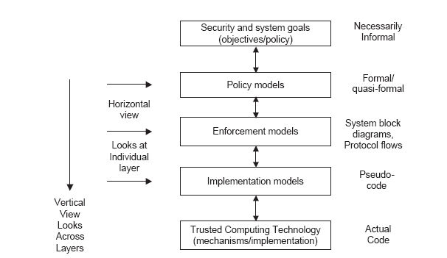
Access Control PEI Layers
Big decisions
Idealized
Enforceable
Codeable
Code

Slide 12
Access Control PEI Layers
Big decisions
Our focus
Idealized
Enforceable
Codeable
Code

Slide 13
Enforcement Models
PUSH
MODEL
Client
Server
Authentication +
Authorization
Credentials
PULL
MODEL
Client
Server
Authentication
Credentials
Authorization
Credentials

Slide 14
Access Control PEI Layers
Big decisions
Our focus
Idealized
Enforceable
Codeable
Code

Slide 15
Access Control
Discretionary Access Control (DAC)
1970
Mandatory Access Control (MAC) 1970
Role Based Access Control (RBAC) 1995
Attribute Based Access Control (ABAC)
Relationship-Based Access Control (ReBAC)
Usage Control (UCON)
2020s (Hopefully)

Slide 16
Discretionary Access Control (DAC)
Core concept:
Custodian of information determines access
Core drawback:
Does not protect copies Therefore OK for integrity but not for confidentiality
Sophistication:
Delegation of custody
Denials or negative rights

Slide 17
Mandatory Access Control (MAC)
Top Secret
Secret
Confidential
Unclassified
can-flow

Slide 18
Mandatory Access Control (MAC)
Core concept:
Extend control to copies by means of security labels
Core drawback:
Covert/side channels bypass MAC
Inference not prevented
Too strict
Too reductionist
Sophistication:
Dynamic labels

Slide 19
Access Control
Discretionary Access Control (DAC)
1970
Mandatory Access Control (MAC) 1970
Role Based Access Control (RBAC) 1995
Attribute Based Access Control (ABAC)
Relationship-Based Access Control (ReBAC)
Usage Control (UCON)
2020s (Hopefully)

Slide 20
Role-Based Access Control (RBAC)
Core concept:
Roles determine everything
Core drawback:
Roles are a natural concept for human users But not so natural for: Information objects IoT things Contextual attributes
Sophistication:
Role hierarchies
Role constraints

Slide 21
Access Control
Discretionary Access Control (DAC)
1970
Mandatory Access Control (MAC) 1970
Role Based Access Control (RBAC) 1995
Attribute Based Access Control (ABAC)
Relationship-Based Access Control (ReBAC)
Usage Control (UCON)
2020s (Hopefully)

Slide 22
Attribute-Based Access Control (ABAC)
Operation
Access
Decision?
Yes/No
Actor
Target
Context

Slide 23
Attribute-Based Access Control (ABAC)
Core concept:
Attributes determine everything
No fixed access decision rule
Core drawback:
Flexibility at the cost of complexity
Sophistication:
Chained attributes
Group attributes
Distributed decision rules
Automation
Adaptation

Slide 24
Access Control
Discretionary Access Control (DAC)
1970
Mandatory Access Control (MAC) 1970
Role Based Access Control (RBAC) 1995
Attribute Based Access Control (ABAC)
Relationship-Based Access Control (ReBAC)
Usage Control (UCON)
2020s (Hopefully)

Slide 25
Access Control: Where Are We?
Rich set of building blocks:
DAC, MAC, RBAC, ABAC, ReBAC, UCON
We have some understanding of the relationships amongst these

Slide 26
Access Control: What Next?
Rich set of building blocks:
DAC, MAC, RBAC, ABAC, ReBAC, UCON
We have some understanding of the relationships amongst these
Do we need more building blocks?
We have very little understanding of synergy amongst these

Slide 27
Access Control: What Next?
Rich set of building blocks:
DAC, MAC, RBAC, ABAC, ReBAC, UCON
We have some understanding of the relationships amongst these
Do we need more building blocks?
We have very little understanding of synergy amongst these
Deep scientific question
for convergent research

Slide 28
Access Control: What Next?
Rich set of building blocks:
DAC, MAC, RBAC, ABAC, ReBAC, UCON
We have some understanding of the relationships amongst these
Do we need more building blocks?
We have very little understanding of synergy amongst these
Deep scientific question
for convergent research
Pressing societal need?

Slide 29
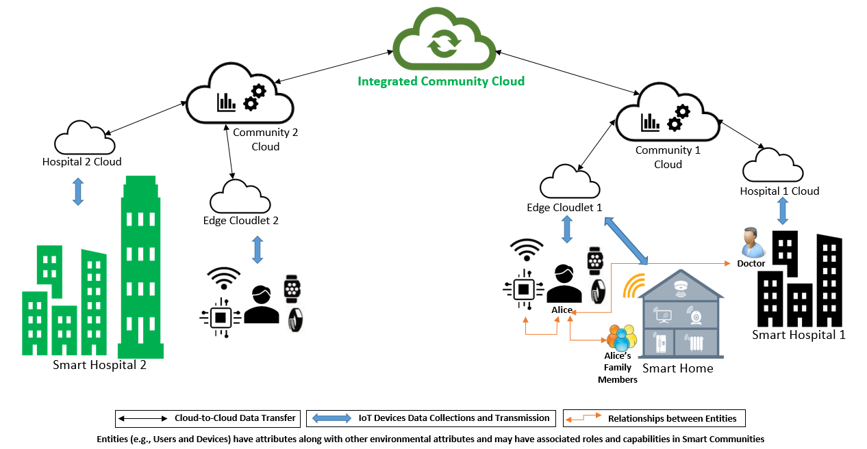
Smart Communities

Slide 30
Access Control Research Convergence
ABAC
ReBAC
RBAC
…
DAC
MAC
Convergent Access Control (CAC)
Access Control Policy Models
Access Control Enforcement Models
Application
Context

