Slide 1
Institute for Cyber Security
Attribute-Based Access Control Models
and Beyond
Prof. Ravi Sandhu
Executive Director, Institute for Cyber Security
Lutcher Brown Endowed Chair in Cyber Security
University of Texas at San Antonio
Indraprastha Institute of Information Technology (IIIT), Delhi
February 14, 2015
ravi.sandhu@utsa.edu, www.profsandhu.com, www.ics.utsa.edu
© Ravi Sandhu
World-Leading Research with Real-World Impact!

Slide 2
Access Control
Discretionary Access Control (DAC), 1970
Mandatory Access Control (MAC), 1970
Role Based Access Control (RBAC), 1995
Attribute Based Access Control (ABAC), ????
© Ravi Sandhu
World-Leading Research with Real-World Impact!
2

Slide 3
The RBAC Story
NIST-ANSI
Standard
Adopted
NIST-ANSI
Standard Proposed
RBAC96
model
Ludwig Fuchs, Gunther Pernul and Ravi Sandhu, Roles in Information Security-A Survey and Classification of the Research Area, Computers & Security, Volume 30, Number 8, Nov. 2011, pages 748-76
© Ravi Sandhu
World-Leading Research with Real-World Impact!
3

Slide 4
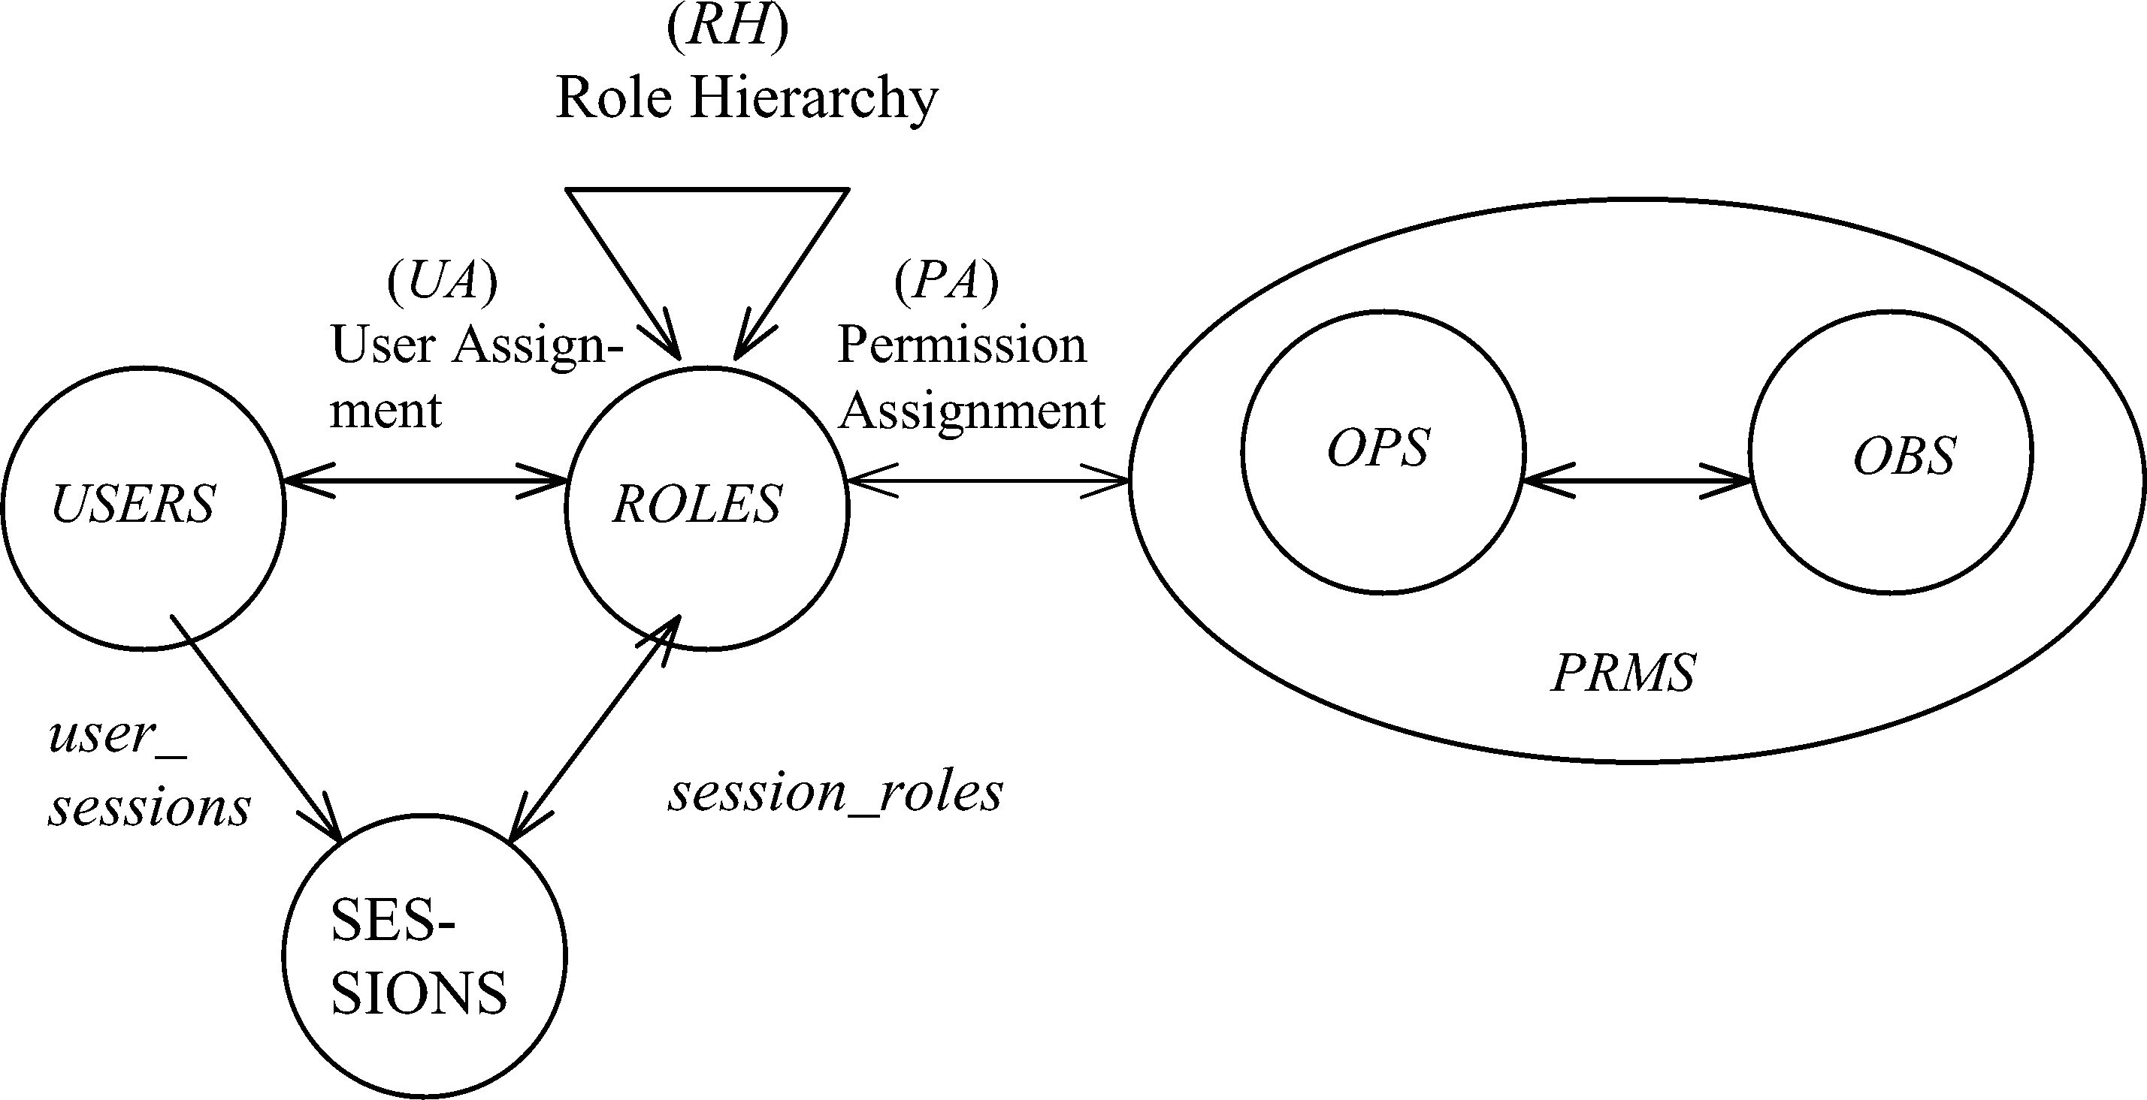
RBAC Shortcomings
Hard Enough
Impossible
Constraints
© Ravi Sandhu
World-Leading Research with Real-World Impact!
4

Slide 5
ABAC is not New
User (Identity)
Attributes
Public-keys +
Secured secrets
© Ravi Sandhu
World-Leading Research with Real-World Impact!

Slide 6
ABAC is not New
User (Identity)
X.500
Directory
X.509
Identity Certificates
Attributes
Public-keys +
Secured secrets
Pre Internet, early 1990s
© Ravi Sandhu
World-Leading Research with Real-World Impact!

Slide 7
ABAC is not New
User (Identity)
X.509
Attribute
Certificates
X.509
Identity Certificates
Attributes
Public-keys +
Secured secrets
Post Internet, late 1990s
© Ravi Sandhu
World-Leading Research with Real-World Impact!

Slide 8
ABAC is not New
User (Identity)
Attributes
SPKI Certificates
Public-keys +
Secured secrets
Post Internet, late 1990s
© Ravi Sandhu
World-Leading Research with Real-World Impact!

Slide 9
ABAC is not New
User (Identity)
Attributes
Anonymous
Credentials
Public-keys +
Secured secrets
Mature Internet, 2000s
© Ravi Sandhu
World-Leading Research with Real-World Impact!

Slide 10
ABAC is not New
Attributes
Action
Authorization Decision
User
Subject
Yes/No
Object
Context
Policy
© Ravi Sandhu
World-Leading Research with Real-World Impact!

Slide 11
ABAC is not New
Attributes
Action
Authorization Decision
User
Subject
Yes/No
Object
Context
Usage Control
XACML
Attribute-Based Encryption
Policy
Mature Internet, 2000s
© Ravi Sandhu
World-Leading Research with Real-World Impact!

Slide 12
ABAC Status
Standard
Adopted
Proposed
Standard
RBAC96
paper
1990?
2014
ABAC still in pre/early phase
© Ravi Sandhu
World-Leading Research with Real-World Impact!
12

Slide 13
Attribute-Based Access Control (ABAC)
Attributes are name:value pairs
  possibly chained
  values can be complex data structures
Associated with
  actions
  users
  subjects
  objects
  contexts
  policies
  Converted by policies into rights just in time
  policies specified by security architects
  attributes maintained by security administrators
  but also possibly by users OR reputation and trust mechanisms
Inherently extensible
© Ravi Sandhu
World-Leading Research with Real-World Impact!
13

Slide 14
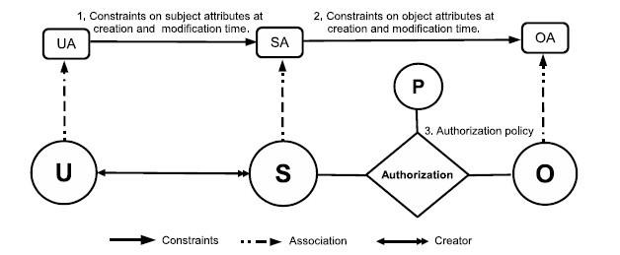
ABACα Model Structure
Policy Configuration Points
Can be configured to do DAC, MAC, RBAC
© Ravi Sandhu
World-Leading Research with Real-World Impact!
14

Slide 15
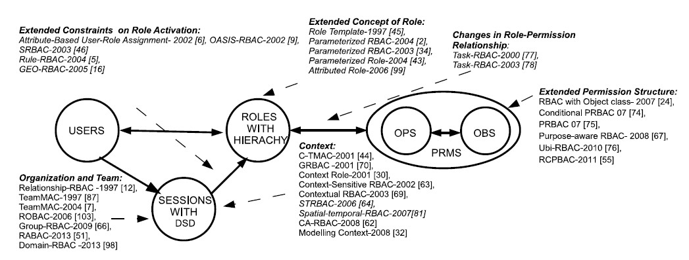
ABAC_{β} Scope
1,4
1, 2, 4, 5
1, 4, 5
4, 5
1, 2, 3, 4, 5
4
1, 4, 5
1. Context Attributes
2. Subject attribute constraints policy are different at creation and modification time.
4. Policy Language
5. Meta-Attributes
3. Subject attributes constrained by attributes of subjects created by the same user.
World-Leading Research with Real-World Impact!
15
Notes:
Give examples about what is excluded

Slide 16
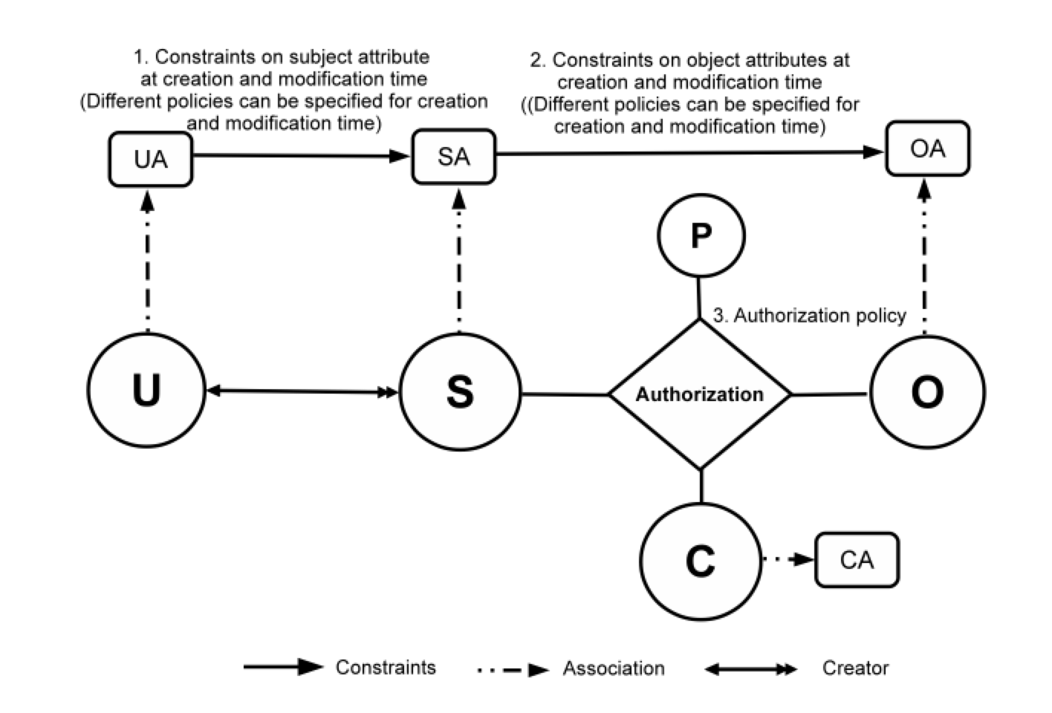
ABAC_{β} Model
16
Notes:
Show abac-alpha
Then for each type of extension, highlight the extensions to ABAC
23 and 24 integrated

Slide 17
Beyond ABAC
Attributes
Security
Access Control
Trust
Risk
Relationships
Provenance
© Ravi Sandhu
World-Leading Research with Real-World Impact!

Slide 18
ABAC Research at ICS
GURA model for user-attribute assignment
Safety analysis of ABAC_{α} and ABAC_{β}
Undecidable safety for ABAC models
Decidable safety for ABAC with finite fixed attributes
Constraints in ABAC
ABAC Cloud IaaS implementations (OpenStack)
Attribute Engineering
Attribute Mining
Unification of Attributes, Relationships and Provenance
© Ravi Sandhu
World-Leading Research with Real-World Impact!
18

