Slide 1
Institute for Cyber Security
The Future of Access Control:
Attributes, Automation and Adaptation
Prof. Ravi Sandhu
Executive Director and Endowed Chair
S&P Symposium
IIT Kanpur
March 1, 2013
ravi.sandhu@utsa.edu
www.profsandhu.com
www.ics.utsa.edu
© Ravi Sandhu
World-Leading Research with Real-World Impact!

Slide 2
Prognosis: Cyberspace
Cyberspace will become orders of magnitude more complex and confused very quickly
Overall this is a very positive development and will enrich human society
It will be messy but need not be chaotic!
Cyber security research and practice are loosing ground
© Ravi Sandhu
World-Leading Research with Real-World Impact!
2

Slide 3
Microsec vs Macrosec
© Ravi Sandhu
World-Leading Research with Real-World Impact!
3
Most cyber security thinking is microsec
Most big cyber security threats are macrosec
Microsec
Retail attacks vs Targeted attacks
99% of the attacks are thwarted by basic hygiene and some luck
1% of the attacks are difficult and expensive, even impossible, to defend or detect
Rational microsec behavior can result in highly vulnerable macrosec

Slide 4
Cyber Security Goal
Enable system designers and operators to say:
This system is secure
There is an infinite supply of low-hanging attacks
Not attainable
© Ravi Sandhu
World-Leading Research with Real-World Impact!
4

Slide 5
Cyber Security Goal
Enable system designers and operators to say:
This system is secure enough
Mass scale, not very high assurance
ATM network
On-line banking
E-commerce
One of a kind, extremely high assurance
US President’s nuclear football
Many successful examples
© Ravi Sandhu
World-Leading Research with Real-World Impact!
5

Slide 6
Cyber Security Paradox
Our successes are not studied as success stories
Our successes are not attainable via current cyber security science, engineering, doctrine
© Ravi Sandhu
World-Leading Research with Real-World Impact!
6

Slide 7
Cyber Security
Cyber Security is all about
tradeoffs and adjustments
automation (in future)
Productivity
Security
Let’s build it
Cash out the benefits
Next generation can secure it
Let’s not build it
Let’s bake in super-security to
make it unusable/unaffordable
Let’s sell unproven solutions
There is a sweet spot in the middle
We don’t know how to predictably find it
and maintain position there
© Ravi Sandhu
World-Leading Research with Real-World Impact!
7

Slide 8
Prognosis: Access Control
Discretionary Access Control (DAC), 1970
Mandatory Access Control (MAC), 1970
Role Based Access Control (RBAC), 1995
Attribute Based Access Control (ABAC), ????
© Ravi Sandhu
World-Leading Research with Real-World Impact!
8

Slide 9
Prognosis: Access Control
Fixed
policy
Discretionary Access Control (DAC), 1970
Mandatory Access Control (MAC), 1970
Role Based Access Control (RBAC), 1995
Attribute Based Access Control (ABAC), ????
Flexible
policy
© Ravi Sandhu
World-Leading Research with Real-World Impact!
9

Slide 10
Prognosis: Access Control
Human
Driven
Discretionary Access Control (DAC), 1970
Mandatory Access Control (MAC), 1970
Role Based Access Control (RBAC), 1995
Attribute Based Access Control (ABAC), ????
Automated
Adaptive
© Ravi Sandhu
World-Leading Research with Real-World Impact!
10

Slide 11
Prognosis: Access Control
Discretionary Access Control (DAC), 1970
Mandatory Access Control (MAC), 1970
Role Based Access Control (RBAC), 1995
Messy or Chaotic?
Attribute Based Access Control (ABAC), ????
© Ravi Sandhu
World-Leading Research with Real-World Impact!
11

Slide 12
Cyber Security Technologies
AUTHENTICATION
RISK
ANALYSIS
ASSURANCE
CRYPTOGRAPHY
ACCESS
CONTROL
INTRUSION
DETECTION
AND AUDIT
SECURITY ENGINEERING
& MANAGEMENT
© Ravi Sandhu
World-Leading Research with Real-World Impact!
12

Slide 13
Access Control Limitations
Analog Hole
Inference
Covert Channels
Side Channels
Phishing
Safety
Usability
Privacy
Attack Asymmetry
Compatibility
Federation
….
© Ravi Sandhu
World-Leading Research with Real-World Impact!
13

Slide 14
Access Control Limitations
Analog Hole
Inference
Covert Channels
Side Channels
Phishing
Safety
Usability
Privacy
Attack Asymmetry
Compatibility
Federation
….
Can manage Cannot eliminate
© Ravi Sandhu
World-Leading Research with Real-World Impact!
14

Slide 15
Access Control Models
Discretionary Access Control (DAC), 1970
Owner controls access
But only to the original, not to copies
Grounded in pre-computer policies of researchers
Mandatory Access Control (MAC), 1970
Synonymous to Lattice-Based Access Control (LBAC)
Access based on security labels
Labels propagate to copies
Grounded in pre-computer military and national security policies
Role-Based Access Control (RBAC), 1995
Access based on roles
Can be configured to do DAC or MAC
Grounded in pre-computer enterprise policies
Numerous other models but only 3 successes: SO FAR
© Ravi Sandhu
World-Leading Research with Real-World Impact!
15

Slide 16
The RBAC Story
NIST-ANSI
Standard
Adopted
NIST-ANSI
Standard Proposed
RBAC96
model
© Ravi Sandhu
World-Leading Research with Real-World Impact!
16

Slide 17
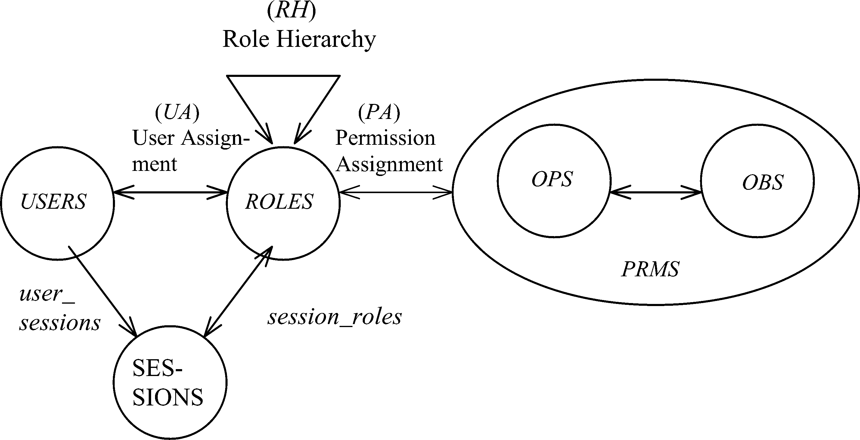
RBAC96 Model
Constraints
© Ravi Sandhu
World-Leading Research with Real-World Impact!
17

Slide 18
Fundamental Theorem of RBAC
RBAC can be configured to do MAC
RBAC can be configured to do DAC
RBAC is policy neutral
RBAC is neither MAC nor DAC!
© Ravi Sandhu
World-Leading Research with Real-World Impact!
18

Slide 19
RBAC Shortcomings
Role granularity is not adequate leading to role explosion
Researchers have suggested several extensions such as parameterized privileges, role templates, parameterized roles (1997-)
Role design and engineering is difficult and expensive
Substantial research on role engineering top down or bottom up (1996-), and on role mining (2003-)
Assignment of users/permissions to roles is cumbersome
Researchers have investigated decentralized administration (1997-), attribute-based implicit user-role assignment (2002-), role-delegation (2000-), role-based trust management (2003-), attribute-based implicit permission-role assignment (2012-)
Adjustment based on local/global situational factors is difficult
Temporal (2001-) and spatial (2005-) extensions to RBAC proposed
RBAC does not offer an extension framework
Every shortcoming seems to need a custom extension
Can ABAC unify these extensions in a common open-ended framework?
© Ravi Sandhu
World-Leading Research with Real-World Impact!
19

Slide 20
RBAC Policy Configuration Points
Security Architect
Security
Administrator
Security
Administrator
Security
Architect
User
Security Architect
Constraints
Security Architect
© Ravi Sandhu
World-Leading Research with Real-World Impact!
20

Slide 21
Access Control Models
Policy
Specification
Policy
Enforcement
Policy
Reality
Policy
Administration
© Ravi Sandhu
World-Leading Research with Real-World Impact!
21

Slide 22
Access Control Models
Policy
Specification
Policy
Enforcement
RBAC, ABAC
Initial focus
Policy
Reality
MAC, DAC
focus
Policy
Administration
© Ravi Sandhu
World-Leading Research with Real-World Impact!
22

Slide 23
Attribute-Based Access Control (ABAC)
Attributes are name:value pairs
possibly chained
values can be complex data structures
Associated with
users
subjects
objects
contexts
device, connection, location, environment, system …
Converted by policies into rights just in time
policies specified by security architects
attributes maintained by security administrators
ordinary users morph into architects and administrators
Inherently extensible
© Ravi Sandhu
World-Leading Research with Real-World Impact!
23

Slide 24
ABAC Status
Standard
Adopted
Proposed
Standard
RBAC96
paper
1990?
2012
ABAC still in pre/early phase
© Ravi Sandhu
World-Leading Research with Real-World Impact!
24

Slide 25
ABAC Prior Work Includes
X.509, SPKI Attribute Certificates (1999 onwards)
IETF RFCs and drafts
Tightly coupled with PKI (Public-Key Infrastructure)
XACML (2003 onwards)
OASIS standard
Narrowly focused on particular policy combination issues
Fails to accommodate the ANSI-NIST RBAC standard model
Fails to address user subject mapping
Usage Control or UCON (Park-Sandhu 2004)
Fails to address user subject mapping
Focus is on extended features
Mutable attributes
Continuous enforcement
Obligations
Conditions
Several others ………..
© Ravi Sandhu
World-Leading Research with Real-World Impact!
25

Slide 26
ABACα Hypothesis (DBSEC 2012)
An ABAC model requires
identification of policy configuration points (PCPs)
languages and formalisms for each PCP
A core set of PCPs can be discovered by building the ABACα model to unify DAC, MAC and RBAC
Additional ABAC models can then be developed by
increasing the sophistication of the ABACα PCPs
discovering additional PCPs driven by requirements beyond DAC, MAC and RBAC
A small but crucial step
© Ravi Sandhu
World-Leading Research with Real-World Impact!
26

Slide 27
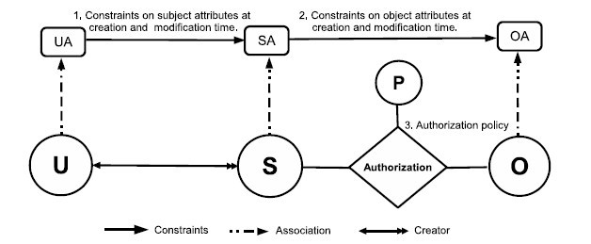
ABACα Model Structure
Policy Configuration Points
© Ravi Sandhu
World-Leading Research with Real-World Impact!
27

Slide 28
ABACα Model Structure
Policy Configuration Points
Can be configured to do DAC, MAC, RBAC
© Ravi Sandhu
World-Leading Research with Real-World Impact!
28

Slide 29
Authorization Leap
Rights to attributes
Rights
Labels
Roles
Attributes
Messy
??
Chaotic
Benefits
Decentralized
Dynamic
Contextual
Consolidated
Risks
Complexity
Confusion
Attribute trust
Policy trust
© Ravi Sandhu
World-Leading Research with Real-World Impact!
29

Slide 30
Prognosis: Cyber Security
Attributes
Automated
Adaptive
Managed but not solved
© Ravi Sandhu
World-Leading Research with Real-World Impact!
30

Slide 31
Prognosis: Cyber Security
Attributes
Automated
Adaptive
Managed but not solved
© Ravi Sandhu
World-Leading Research with Real-World Impact!
31

Slide 32
Cyber Security Research at ICS
Applications
Secure information sharing
Social networks security and privacy
Secure data provenance
Content delivery networks
Smart grid
Technology
Cloud computing security
Software defined networks
Botnets
Foundations
Attribute based access control
Relationship based access control
Malware models
© Ravi Sandhu
World-Leading Research with Real-World Impact!
32

