Slide 1
Access Control
Evolution and Prospects
Ravi Sandhu
Executive Director
Professor of Computer Science
Lutcher Brown Chair in Cyber Security
October 2019
ravi.sandhu@utsa.edu
www.ics.utsa.edu
www.profsandhu.com

Slide 2
Holistic Cyber Security
Objectives
POLICY
ATTACKS
Enable
What?
Why?
Respond
Enforce
Defend
PROTECT
How?
DETECT
Mechanisms
Complement

Slide 3
Cyber Security
Fundamental Technologies
Access Control: Authentication, Authorization
Cryptography: Symmetric, Assymetric
Detection: Signature, Zero Day
Recovery/Recourse: Backups, Forensics
Tolerance/Resilience: Mission Assurance
……….

Slide 4
Cyber Security
Fundamental Limits
Copy control
Inference
Analog hole
Trusting humans vs trusting software
Trusted computing base vulnerabilities
Side channels and covert channels
…………….

Slide 5
Cryptography
Symmetric Key Cryptography, 1977
Asymmetric Key Cryptography, 1996
BlockChain Applications, ????

Slide 6
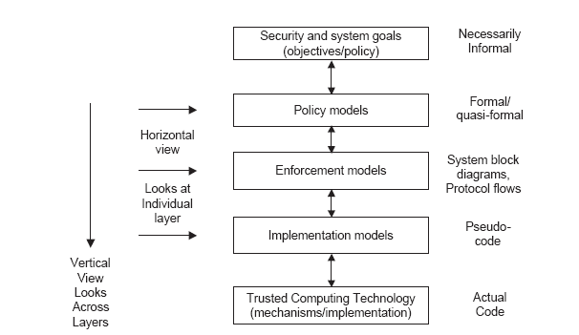
Access Control
PEI Layers
Assumes Successful Authentication
Idealized
Enforceable
(Approximate)
Codeable

Slide 7
Access Control
Discretionary Access Control (DAC), 1970
Mandatory Access Control (MAC), 1970
Role Based Access Control (RBAC), 1995
Attribute Based Access Control (ABAC), ????

Slide 8
Discretionary Access Control (DAC)
Core concept:
Custodian of information determines access
Core drawback:
Does not protect copies
Therefore OK for integrity but not for confidentiality
Sophistication:
Delegation of custody
Denials or negative rights

Slide 9
Mandatory Access Control (MAC)
Top Secret
Secret
Confidential
Unclassified
can-flow

Slide 10
Mandatory Access Control (MAC)
Core concept:
Extend control to copies by means of security labels
Core drawback:
Covert/side channels bypass MAC
Inference not prevented
Too strict
Too reductionist
Sophistication:
Dynamic labels

Slide 11
Access Control
Discretionary Access Control (DAC), 1970
Mandatory Access Control (MAC), 1970
Role Based Access Control (RBAC), 1995
Attribute Based Access Control (ABAC), ????

Slide 12
Role-Based Access Control (RBAC)
Primary-Care
Physician
Specialist
Physician
Physician
Health-Care Provider

Slide 13
Role-Based Access Control (RBAC)
Core concept:
Roles determine everything
Core drawback:
Roles are a natural concept for human users
But not so natural for:
Information objects
IoT things
Contextual attributes
Sophistication:
Role hierarchies
Role constraints

Slide 14
Role-Based Access Control (RBAC)
Fundamental theorem of RBAC:
RBAC can be configured to do DAC
RBAC can be configured to do MAC

Slide 15
Access Control
Discretionary Access Control (DAC), 1970
Mandatory Access Control (MAC), 1970
Role Based Access Control (RBAC), 1995
Attribute Based Access Control (ABAC), ????

Slide 16
Attribute-Based Access Control (ABAC)
Operation
Access
Decision?
Yes/No
Actor
Target
Context

Slide 17
Attribute-Based Access Control (ABAC)
Core concept:
Attributes determine everything
No fixed access decision rule
Core drawback:
Flexibility at the cost of complexity
Sophistication:
Chained attributes
Group attributes
Distributed decision rules
Automation
Adaptation

Slide 18
Access Control
Discretionary Access Control (DAC), 1970
Mandatory Access Control (MAC), 1970
Role Based Access Control (RBAC), 1995
Attribute Based Access Control (ABAC), ????

Slide 19
ABAC Research Space
7. ABAC Design, Engineering and Applications
3. Administrative
ABAC Models
4. Extended
ABAC Models
5. ABAC Policy
Architectures and Languages
6. ABAC Enforcement Architectures
2. Core ABAC Models
1. Foundational Principles and Theory

Slide 20
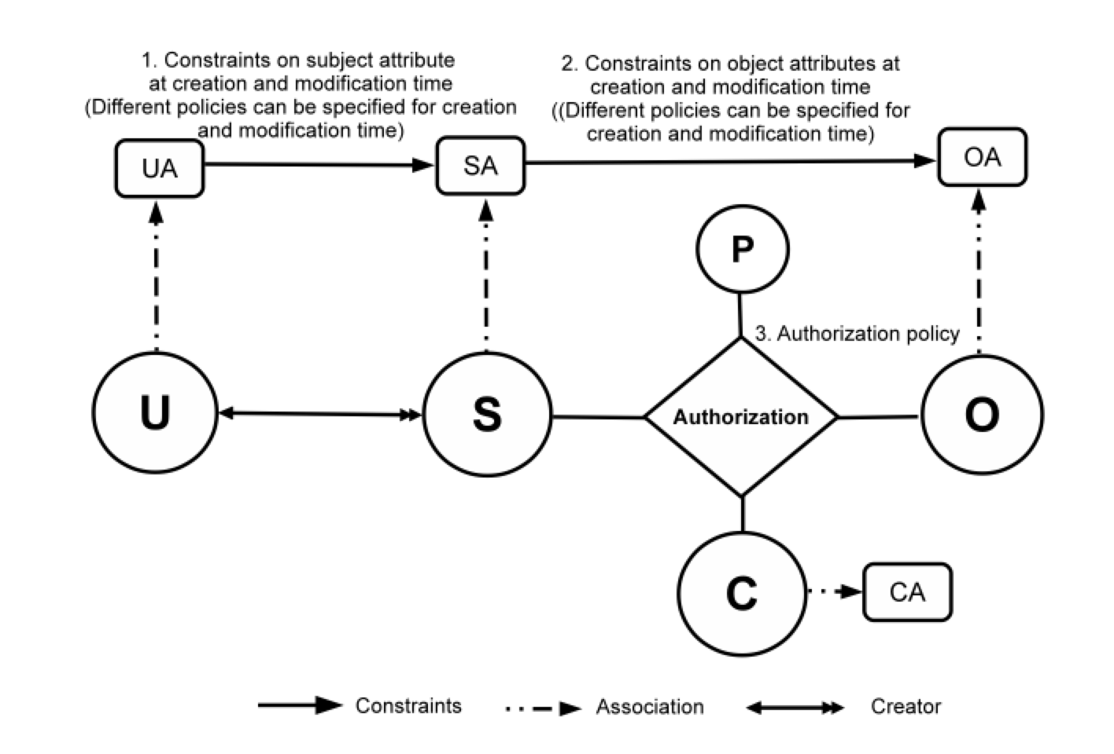
Core ABAC Models: ABAC_{β}

Slide 21
Core ABAC Models: ABAC_{β}
Policy Configuration Points
Can be configured to do various forms of DAC, MAC, RBAC (Jin, Krishnan, Sandhu 2012)

Slide 22
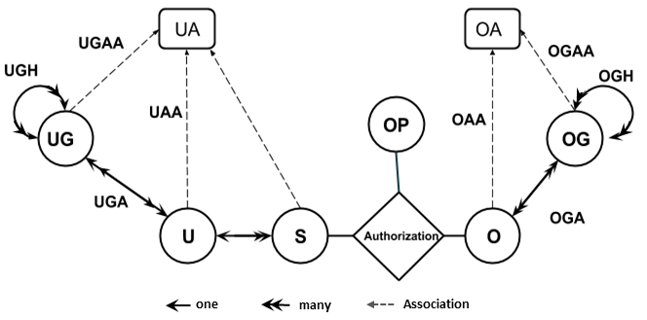
Administrative ABAC Models: HGABAC
Hierarchical Group and Attribute Based Access Control (HGABAC)
  Introduces User and Object Groups
  Simplifies administration of attributes
Servos and Osborn, 2015

Slide 23
ABAC Applications:
Cloud Enabled IoT
Alsheri, Bhatt, Patwa, Benson, Sandhu
2016 onwards

Slide 24
Policy Architecture:
Amazon AWS style

Slide 25
ABAC Enforcement Architecture: Federated ABAC
Fisher 2015
NCCOE, NIST, Building Block

Slide 26
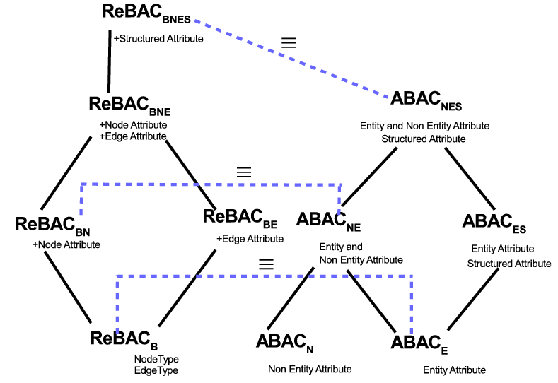
Extended ABAC Models: ReBAC versus ABAC
ReBAC and ABAC are not that different
(Tahmina, Sandhu 2017)

Slide 27
Foundations: Safety Analysis
Discretionary Access Control (DAC), 1970
Mandatory Access Control (MAC), 1970
Can subject s obtain a right r on object o?
Current state?
Some future state?
Role Based Access Control (RBAC), 1995
Safety
Complexity
Attribute Based Access Control (ABAC), ????
Ahmed, Rajkumar, Sandhu
2016 onwards

