Slide 1
Institute for Cyber Security: Research Vision
Ravi Sandhu Executive Director and Chief Scientist
Professor of Computer Science Lutcher Brown Chair in Cyber Security
NSA-UTSA Partnership Briefing October 27, 2017
ravi.sandhu@utsa.edu www.ics.utsa.edu www.cspecc.utsa.edu www.profsandhu.com

Slide 2
ICS Mission and History
MISSION
Sustained excellence in graduate-level sponsored research
2007-2012
Founded by start-up funding from State of Texas
2012-2017
Graduated to a self-sustaining operation
2017-2022
Major expansion by winning NSF C-SPECC grant
Situated in the College of Science, Department of Computer Science
Established world class laboratories for: Secure cloud computing and Malware research
In collaboration with:
College of Engineering
College of Business
College of Education
Open Cloud Institute
Cyber Center for Security & Analytics

Slide 3
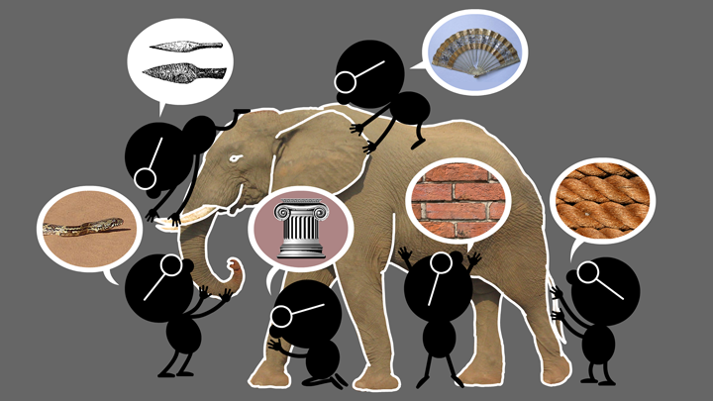
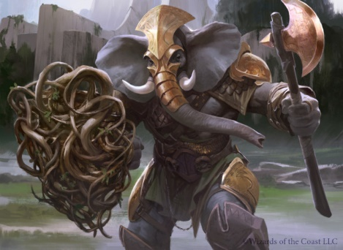
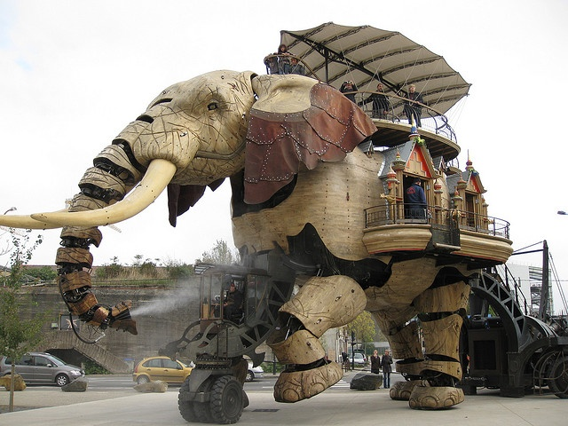
Natural vs Cyber Science
Elephant Problem
Cyber-Elephant Problem
The cyber-elephant problem requires Applied and Basic research Combined (ABC)
* The New ABCs of Research, Ben Schneiderman, 2016

Slide 4
ICS Major Research Areas
TECHNOLOGIES
Access Control
Policy
Malware
Detection and Forensics
Security Dynamics
APPLICATION DOMAINS
Cloud Computing
Internet of Things (IoT)
Social Networks
Enterprise
Goal: Broaden and Deepen

Slide 5
Cyber Security Landscape
Objectives
POLICY
ATTACKS
Enable
What?
Why?
Respond
Enforce
Defend
PROTECT
How?
DETECT
Mechanisms
Complement

Slide 6
Research Approaches
Divide and Conquer
Develop point solutions to point problems
Compose and Compensate
Build system level solutions from smaller component solutions
Bright
Shiny
Objects
Hard Unapproachable Problems

