Slide 1
Institute for Cyber Security
The Authorization Leap from Rights to Attributes:
Maturation or Chaos?
Prof. Ravi Sandhu
Executive Director and Endowed Chair
PST
July 16, 2012
ravi.sandhu@utsa.edu
www.profsandhu.com
www.ics.utsa.edu
© Ravi Sandhu
World-Leading Research with Real-World Impact!

Slide 2
Institute for Cyber Security
The Authorization Leap from Rights to Attributes:
Maturation or Chaos?
Messy or Chaotic?
Prof. Ravi Sandhu
Executive Director and Endowed Chair
PST
July 16, 2012
ravi.sandhu@utsa.edu
www.profsandhu.com
www.ics.utsa.edu
© Ravi Sandhu
World-Leading Research with Real-World Impact!

Slide 3
Prognosis: Cyberspace
Cyberspace will become orders of magnitude more complex and confused very quickly
Overall this is a very positive development and will enrich human society
It will be messy but need not be chaotic!
© Ravi Sandhu
World-Leading Research with Real-World Impact!
3

Slide 4
Prognosis: Access Control
Discretionary Access Control (DAC), 1970
Mandatory Access Control (MAC), 1970
Role Based Access Control (RBAC), 1995
Attribute Based Access Control (ABAC), ????
© Ravi Sandhu
World-Leading Research with Real-World Impact!
4

Slide 5
Prognosis: Access Control
Fixed
policy
Discretionary Access Control (DAC), 1970
Mandatory Access Control (MAC), 1970
Role Based Access Control (RBAC), 1995
Attribute Based Access Control (ABAC), ????
Flexible
policy
© Ravi Sandhu
World-Leading Research with Real-World Impact!
5

Slide 6
Prognosis: Access Control
Fixed
policy
Discretionary Access Control (DAC), 1970
Mandatory Access Control (MAC), 1970
Role Based Access Control (RBAC), 1995
Messy or Chaotic?
Attribute Based Access Control (ABAC), ????
Flexible
policy
© Ravi Sandhu
World-Leading Research with Real-World Impact!
6

Slide 7
Cyber Security Technologies
AUTHENTICATION
RISK
ANALYSIS
ASSURANCE
CRYPTOGRAPHY
ACCESS
CONTROL
INTRUSION
DETECTION
AND AUDIT
SECURITY ENGINEERING
& MANAGEMENT
© Ravi Sandhu
World-Leading Research with Real-World Impact!
7

Slide 8
Access Control Limitations
Analog Hole
Inference
Covert Channels
Side Channels
Phishing
Safety
Usability
Privacy
Attack Asymmetry
Compatibility
Federation
….
© Ravi Sandhu
World-Leading Research with Real-World Impact!
8

Slide 9
Access Control Limitations
Analog Hole
Inference
Covert Channels
Side Channels
Phishing
Safety
Usability
Privacy
Attack Asymmetry
Compatibility
Federation
….
Can manage Cannot eliminate
© Ravi Sandhu
World-Leading Research with Real-World Impact!
9

Slide 10
Access Control Models
Discretionary Access Control (DAC), 1970
Owner controls access
But only to the original, not to copies
Grounded in pre-computer policies of researchers
Mandatory Access Control (MAC), 1970
Synonymous to Lattice-Based Access Control (LBAC)
Access based on security labels
Labels propagate to copies
Grounded in pre-computer military and national security policies
Role-Based Access Control (RBAC), 1995
Access based on roles
Can be configured to do DAC or MAC
Grounded in pre-computer enterprise policies
Numerous other models but only 3 successes: SO FAR
© Ravi Sandhu
World-Leading Research with Real-World Impact!
10

Slide 11
The RBAC Story
NIST-ANSI
Standard
Adopted
NIST-ANSI
Standard Proposed
RBAC96
model
© Ravi Sandhu
World-Leading Research with Real-World Impact!
11

Slide 12
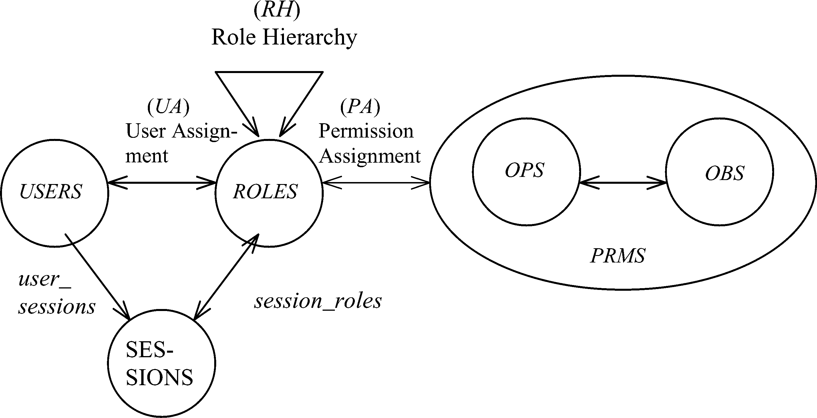
RBAC96 Model
Constraints
© Ravi Sandhu
World-Leading Research with Real-World Impact!
12

Slide 13
Fundamental Theorem of RBAC
RBAC can be configured to do MAC
RBAC can be configured to do DAC
RBAC is policy neutral
RBAC is neither MAC nor DAC!
© Ravi Sandhu
World-Leading Research with Real-World Impact!
13

Slide 14
RBAC Shortcomings
Role granularity is not adequate leading to role explosion
Researchers have suggested several extensions such as parameterized privileges, role templates, parameterized roles (1997-)
Role design and engineering is difficult and expensive
Substantial research on role engineering top down or bottom up (1996-), and on role mining (2003-)
Assignment of users/permissions to roles is cumbersome
Researchers have investigated decentralized administration (1997-), attribute-based implicit user-role assignment (2002-), role-delegation (2000-), role-based trust management (2003-), attribute-based implicit permission-role assignment (2012-)
Adjustment based on local/global situational factors is difficult
Temporal (2001-) and spatial (2005-) extensions to RBAC proposed
RBAC does not offer an extension framework
Every shortcoming seems to need a custom extension
Can ABAC unify these extensions in a common open-ended framework?
© Ravi Sandhu
World-Leading Research with Real-World Impact!
14

Slide 15
RBAC Policy Configuration Points
Security Architect
Security
Administrator
Security
Administrator
Security
Architect
User
Security Architect
Constraints
Security Architect
© Ravi Sandhu
World-Leading Research with Real-World Impact!
15

Slide 16
Access Control Models
Policy
Specification
Policy
Enforcement
Policy
Reality
Policy
Administration
© Ravi Sandhu
World-Leading Research with Real-World Impact!
16

Slide 17
Access Control Models
Policy
Specification
Policy
Enforcement
RBAC, ABAC
Initial focus
Policy
Reality
MAC, DAC
focus
Policy
Administration
© Ravi Sandhu
World-Leading Research with Real-World Impact!
17

Slide 18
Attribute-Based Access Control (ABAC)
Attributes are name:value pairs
possibly chained
values can be complex data structures
Associated with
users
subjects
objects
contexts
device, connection, location, environment, system …
Converted by policies into rights just in time
policies specified by security architects
attributes maintained by security administrators
ordinary users morph into architects and administrators
Inherently extensible
© Ravi Sandhu
World-Leading Research with Real-World Impact!
18

Slide 19
ABAC Status
Standard
Adopted
Proposed
Standard
RBAC96
paper
1990?
2012
ABAC still in pre/early phase
© Ravi Sandhu
World-Leading Research with Real-World Impact!
19

Slide 20
ABAC Prior Work Includes
X.509, SPKI Attribute Certificates (1999 onwards)
IETF RFCs and drafts
Tightly coupled with PKI (Public-Key Infrastructure)
XACML (2003 onwards)
OASIS standard
Narrowly focused on particular policy combination issues
Fails to accommodate the ANSI-NIST RBAC standard model
Fails to address user subject mapping
Usage Control or UCON (Park-Sandhu 2004)
Fails to address user subject mapping
Focus is on extended features
Mutable attributes
Continuous enforcement
Obligations
Conditions
Several others ………..
© Ravi Sandhu
World-Leading Research with Real-World Impact!
20

Slide 21
ABACα Hypothesis (DBSEC 2012)
An ABAC model requires
identification of policy configuration points (PCPs)
languages and formalisms for each PCP
A core set of PCPs can be discovered by building the ABACα model to unify DAC, MAC and RBAC
Additional ABAC models can then be developed by
increasing the sophistication of the ABACα PCPs
discovering additional PCPs driven by requirements beyond DAC, MAC and RBAC
A small but crucial step
© Ravi Sandhu
World-Leading Research with Real-World Impact!
21

Slide 22
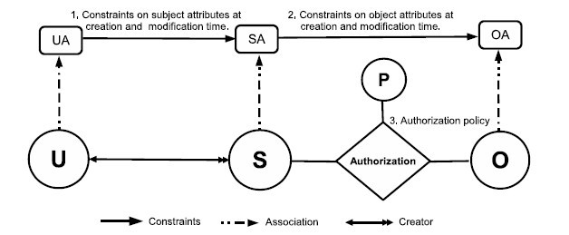
ABACα Model Structure
Policy Configuration Points
© Ravi Sandhu
World-Leading Research with Real-World Impact!
22

Slide 23
Authorization Policy: LAuthorization
DAC
MAC
RBAC0
RBAC1
© Ravi Sandhu
World-Leading Research with Real-World Impact!
23

Slide 24
Subject Attribute Constraints； LConstrSub
MAC
RBAC0
RBAC1
© Ravi Sandhu
World-Leading Research with Real-World Impact!
24

Slide 25
Object Attribute Constraints
Constraints at creation: LConstrObj
DAC
MAC
DAC
Constraints at modification: LConstrObjMod
© Ravi Sandhu
World-Leading Research with Real-World Impact!
25

Slide 26
ABACα Model Structure
Policy Configuration Points
Future work
increasing the sophistication of the ABACα PCPs
discovering additional PCPs
© Ravi Sandhu
World-Leading Research with Real-World Impact!
26

Slide 27
ABAC Research Agenda
7. ABAC Design and Engineering
3. Administrative
ABAC Models
4. Extended
ABAC Models
5. ABAC Policy Languages
6. ABAC Enforcement Architectures
2. Core ABAC Models
1. Foundational Principles and Theory
© Ravi Sandhu
World-Leading Research with Real-World Impact!
27

Slide 28
ABAC Research Agenda
7. ABAC Design and Engineering
3. Administrative
ABAC Models
4. Extended
ABAC Models
5. ABAC Policy Languages
6. ABAC Enforcement Architectures
2. Core ABAC Models
Initial Results
1. Foundational Principles and Theory
© Ravi Sandhu
World-Leading Research with Real-World Impact!
28

Slide 29
ABAC Research Agenda:
RBAC Inspiration
7. Design and Engineering:
Role engineering: Coyne (1996), Thomsen et al (1999), Epstein-Sandhu (2001), Strembeck (2005)
Role mining: Kuhlmann-Schimpf (2003), RoleMiner (2006, 2007), Minimal Perturbation (2008)
5. Policy Languages Constraints: RCL (2000), Jaeger-Tidswell (2001), Crampton (2003), ROWLBAC (2008)
User-role assignment:
RB-RBAC (2002), RT (2003)
3. Administrative Models: ARBAC97 (1997), RBDM (2000), RDM (2000), RB-RBAC (2002), ARBAC02 (2002), PBDM (2003) ARBAC07 (2007), SARBAC (2003, 2007)
4. Extended Models: TMAC (1997) Workflow (1999), T-RBAC (2000), OrBAC (2003), TRBAC (2001), RT (2003), GTRBAC (2005), GEO-RBAC (2005), P-RBAC (2007)
6. Enforcement Architectures: Ferraiolo et al (1999), OM-AM (2000), Park et al (2001), xoRBAC (2001), RCC (2003), RB-GACA (2005), XACML Profiles (2004, 2005, 2006)
2. Core Models: RBAC96 (1996), ANSI-NIST Standard (2000, 2004)
1. Foundational Principles and Theory
Principles: RBAC96 (1996), OM-AM (2000), NIST Standard (2000, 2004), PEI (2006), ASCAA (2008)
Theory: ATAM Simulation (1999), LBAC-DAC Simulations (2000), Li-Tripunitara (2006), Stoller et al (2006, 2007), Jha et al (2008)
NOTE: Only a small sampling of the RBAC literature is cited in this diagram
© Ravi Sandhu
World-Leading Research with Real-World Impact!
29

Slide 30
Authorization Leap
Rights to attributes
Rights
Labels
Roles
Attributes
Messy
??
Chaotic
Benefits
Decentralized
Dynamic
Contextual
Consolidated
Risks
Complexity
Confusion
Attribute trust
Policy trust
© Ravi Sandhu
World-Leading Research with Real-World Impact!
30

