Slide 1
Institute for Cyber Security
The Data and Application Security and Privacy (DASPY) Challenge
Prof. Ravi Sandhu
Executive Director and Endowed Chair
October 31, 2011
ravi.sandhu@utsa.edu
www.profsandhu.com
www.ics.utsa.edu
© Ravi Sandhu
World-Leading Research with Real-World Impact!

Slide 2
The ATM “Paradox”
The ATM (Automatic Teller Machine) network is
  secure enough (but insecure)
  global in scope and rapidly growing
But
  not securable by academically taught cyber security
  not studied as a success story
  missing technologies highly regarded by academia
Similar “paradoxes” apply to
  on-line banking
  e-commerce
  etc
© Ravi Sandhu
World-Leading Research with Real-World Impact!
2

Slide 3
Cyber Security Status
Cyber technologies and systems have evolved
Cyber attacks and attackers have evolved
    Side note: all attackers are not evil
Cyber security (defensive) goals have evolved
  Computer security
  Information security = Computer security + Communications security
  Information assurance
  Mission assurance
© Ravi Sandhu
World-Leading Research with Real-World Impact!
3

Slide 4
Cyber Security Research Status
Cyber security research (and practice) are rapidly loosing ground
  evolving glacially
  in spite of increase in funding and many innovative research advances
  in spite of numerous calls for “game changing” research
Grand challenge: how to become relevant to the real world
© Ravi Sandhu
World-Leading Research with Real-World Impact!
4

Slide 5
Cyber Security Research Status
We need to do something different
Rough analogies
  software engineering vis a vis programming
  data models (e.g., entity-relationship) vis a vis data structures (e,g., B trees)
© Ravi Sandhu
World-Leading Research with Real-World Impact!
5

Slide 6
Cyber Security Characteristics
Cyber Security is all about tradeoffs
Productivity
Security
Let’s build it
Cash out the benefits
Next generation can secure it
Let’s not build it
Let’s bake in super-security to
make it unusable/unaffordable
Let’s mandate unproven solutions
There is a sweet spot
We don’t know how to predictably find it
© Ravi Sandhu
World-Leading Research with Real-World Impact!
6

Slide 7
Cyber Security Characteristics
Tech-
Light
Tech-
Medium
Tech-
Heavy
High-tech
+
High-touch
© Ravi Sandhu
World-Leading Research with Real-World Impact!
7

Slide 8
Cyber Security Characteristics
© Ravi Sandhu
World-Leading Research with Real-World Impact!
8
Microsec versus Macrosec
  Most cyber security thinking is microsec
  Most big (e.g., national level) cyber security threats are macrosec
Rational microsec behavior can result in highly vulnerable macrosec

Slide 9
Cyber Security Characteristics
HIGH
perception
LOW
HIGH
reality
© Ravi Sandhu
World-Leading Research with Real-World Impact!
9

Slide 10
Cyber Security Characteristics
© Ravi Sandhu
World-Leading Research with Real-World Impact!
10
How to justify investing in security in presence of persistent insecurity?
And, where to invest?
  mitigate known attacks in the wild?
  mitigate anticipated attacks?
  mitigate ultimate attacks?
  some combination?

Slide 11
Academic Challenge
Develop a scientific discipline
  to cover (at least) the previous characteristics
  that can be meaningfully taught in Universities at all levels: BS, MS, PhD
Prognosis
  we shall succeed (we have no choice)
© Ravi Sandhu
World-Leading Research with Real-World Impact!
11

Slide 12
Driving Principles
Insecurity is inevitable
  Death is inevitable
Security investment is nevertheless justified
  Mortals nevertheless seek medical care
Too much security can be counter productive
  So can too much medical care
© Ravi Sandhu
World-Leading Research with Real-World Impact!
12

Slide 13
Central Question
How can we be “secure” while being “insecure”?
  versus
How can we be “secure”?
© Ravi Sandhu
World-Leading Research with Real-World Impact!
13

Slide 14
How Secure? How Insecure?
Sometimes aiming high is very appropriate
  The President’s nuclear football
  Secret formula for Coca Cola
Sometimes not
    ATM network
    On-line banking
    E-commerce (B2C)
© Ravi Sandhu
World-Leading Research with Real-World Impact!
14

Slide 15
Why is the ATM System Secure?
Application Centric
© Ravi Sandhu
World-Leading Research with Real-World Impact!
15
Monetary loss is easy to quantify and compensate
Security principles
  stop loss mechanisms
  audit trail (including physical video)
  retail loss tolerance with recourse
  wholesale loss avoidance
Technical surprises
  no asymmetric cryptography
  no annonymity

Slide 16
Cyber Security Research
Application
Centric
Technology
Centric
Attack
Centric
FOUNDATIONS
Building blocks and theory
© Ravi Sandhu
World-Leading Research with Real-World Impact!
16

Slide 17
The DASPY System Challenge
Security and system goals
(objectives/policy)
Necessarily informal
P
E
I
M
O
D
E
L
S
Specified using users, subjects, objects, admins, labels, roles, groups, etc. in an ideal setting.
Security analysis (objectives, properties, etc.).
Policy models
Approximated policy realized using system architecture with trusted servers, protocols, etc.
Enforcement level security analysis (e.g. stale information due to network latency, protocol proofs, etc.).
Enforcement models
Implementation models
Technologies such as Cloud Computing, Trusted Computing, etc.
Implementation level security analysis (e.g. vulnerability analysis, penetration testing, etc.)
Concrete System
Software and Hardware
© Ravi Sandhu
World-Leading Research with Real-World Impact!

Slide 18
RBAC96 Model (P Layer)
ROLE HIERARCHIES
USER-ROLE
ASSIGNMENT
PERMISSIONS-ROLE
ASSIGNMENT
USERS
ROLES
PERMISSIONS
...
SESSIONS
CONSTRAINTS
© Ravi Sandhu
World-Leading Research with Real-World Impact!
18

Slide 19
Server Pull Model (E Layer)
Client
Server
User-role
Authorization
Server
© Ravi Sandhu
World-Leading Research with Real-World Impact!
19

Slide 20
Client Pull Model (E Layer)
Client
Server
User-role
Authorization
Server
© Ravi Sandhu
World-Leading Research with Real-World Impact!
20

Slide 21
The DASPY System Challenge
Security and system goals
(objectives/policy)
Necessarily informal
P
E
I
M
O
D
E
L
S
Specified using users, subjects, objects, admins, labels, roles, groups, etc. in an ideal setting.
Security analysis (objectives, properties, etc.).
Policy models
Approximated policy realized using system architecture with trusted servers, protocols, etc.
Enforcement level security analysis (e.g. stale information due to network latency, protocol proofs, etc.).
Enforcement models
Implementation models
Technologies such as Cloud Computing, Trusted Computing, etc.
Implementation level security analysis (e.g. vulnerability analysis, penetration testing, etc.)
Concrete System
Software and Hardware
© Ravi Sandhu
World-Leading Research with Real-World Impact!

Slide 22
g-SIS Model (P layer)
Operational aspects
  Group operation semantics
    Add, Join, Leave, Remove, etc
    Multicast group is one example
  Object model
    Read-only
    Read-Write (no versioning vs versioning)
  User-subject model
    Read-only Vs read-write
  Policy specification
Administrative aspects
  Authorization to create group, user join/leave, object add/remove, etc.
join
Users
leave
Group
Authz (u,o,r)?
add
remove
Objects
© Ravi Sandhu
World-Leading Research with Real-World Impact!

Slide 23
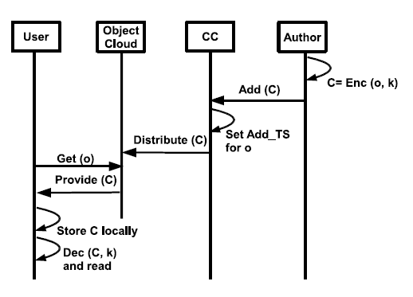
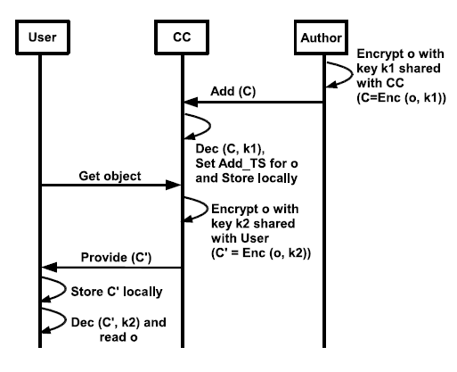
g-SIS Model (E layer)
Super-Distribution (SD)
Micro-Distribution (MD)
Scalability/Performance
  SD: Encrypt once, access where authorized
  MD: Custom encrypt for each user on initial access
Assurance/Recourse
  SD: Compromise one client, compromise group key
  MD: Compromise of one client contained to objects on that client
© Ravi Sandhu
World-Leading Research with Real-World Impact!

Slide 24
Conclusion
How can we be “secure” while being “insecure”?
  versus
How can we be “secure”?
© Ravi Sandhu
World-Leading Research with Real-World Impact!
24

