Slide 1
Access Control Convergence: Challenges and Opportunities
Ravi Sandhu
Executive Director and Chief Scientist
Institute for Cyber Security
Professor of Computer Science
Lutcher Brown Chair in Cyber Security
UBISEC
December 29, 2021
ravi.sandhu@utsa.edu www.ics.utsa.edu www.profsandhu.com

Slide 2
Convergent Research
Disciplinary
INCREASED
Collaboration
Interaction
New paradigms
New concepts
New language
New disciplines
Multi-Disciplinary
Inter-Disciplinary
Convergent

Slide 3
Convergent Research
Disciplinary
INCREASED
Collaboration
Interaction
New paradigms
New concepts
New language
New disciplines
Multi-Disciplinary
Inter-Disciplinary
NAP Report 2005
Convergent
NAP Report 2014
NAP = National Academies Press

Slide 4
Convergent Research
Disciplinary
INCREASED
Collaboration
Interaction
New paradigms
New concepts
New language
New disciplines
Multi-Disciplinary
Inter-Disciplinary
Cross-Disciplinary
Convergent
Trans-Disciplinary

Slide 5
Convergent Research
Disciplinary
INCREASED
Collaboration
Interaction
New paradigms
New concepts
New language
New disciplines
Multi-Disciplinary
Inter-Disciplinary
Convergent
DRIVERS
-- Deep scientific questions
-- Pressing societal needs

Slide 6
Cyber Security Research Convergence
Objectives
POLICY
ATTACKS
Enable
What?
Why?
Respond
Enforce
Defend
PROTECT
How?
DETECT
Application
Context
Mechanisms
Complement

Slide 7
Cyber Security Research Convergence
Objectives
POLICY
ATTACKS
Enable
What?
Why?
Respond
Deep scientific questions:
-- We have no clue how to do this
Pressing societal need:
-- Cyber security is hugely important and broken
-- Cyber security researchers lack incentive to converge
Enforce
Defend
PROTECT
How?
DETECT
Application
Context
Mechanisms
Complement

Slide 8
Access Control Research Convergence
ABAC
ReBAC
RBAC
…
DAC
MAC
Convergent Access Control (CAC)
Access Control Policy Models
Access Control Enforcement Models
Application
Context

Slide 9
Access Control Research Convergence
ABAC
ReBAC
RBAC
Deep scientific questions:
-- We have no clue how to do this
-- Will revisit at end of of talk
Pressing societal need:
-- Cyber security is hugely important and broken
-- Access control is an essential piece to secure modern
cyber applications: IoT, CPS, smart communities, …
-- Cyber security researchers have no incentive to converge
-- Convergence may be easier in Access Control vs all of cyber security
…
DAC
MAC
Convergent Access Control (CAC)
Access Control Policy Models
Access Control Enforcement Models
Application
Context

Slide 10
Access Control
Discretionary Access Control (DAC)
1970
Mandatory Access Control (MAC) 1970
Role Based Access Control (RBAC) 1995
Attribute Based Access Control (ABAC)
Relationship-Based Access Control (ReBAC)
Usage Control (UCON)
2020s (Hopefully)

Slide 11
Discretionary Access Control (DAC)
Core concept:
Custodian of information determines access
Core drawback:
Does not protect copies
Therefore OK for integrity but not for confidentiality
Sophistication:
Delegation of custody
Denials or negative rights

Slide 12
Mandatory Access Control (MAC)
Core concept:
One-way information flow via security labels
Controls on originals and copies
Core drawback:
Covert/side channels bypass MAC
Inference not prevented
Too strict
Too reductionist
Sophistication:
Dynamic labels

Slide 13
Access Control
Discretionary Access Control (DAC)
1970
Mandatory Access Control (MAC) 1970
Role Based Access Control (RBAC) 1995
Attribute Based Access Control (ABAC)
Relationship-Based Access Control (ReBAC)
Usage Control (UCON)
2020s (Hopefully)

Slide 14
Role-Based Access Control (RBAC)
Core concept:
Roles determine everything
Core drawback:
Roles are a natural concept for human users
But not so natural for:
Information objects
IoT things
Contextual attributes
Sophistication:
Role hierarchies
Role constraints

Slide 15
Access Control
Discretionary Access Control (DAC)
1970
Mandatory Access Control (MAC) 1970
Role Based Access Control (RBAC) 1995
Attribute Based Access Control (ABAC)
Relationship-Based Access Control (ReBAC)
Usage Control (UCON)
2020s (Hopefully)

Slide 16
Attribute-Based Access Control (ABAC)
Operation
Access
Decision?
Yes/No
Actor
Target
Context

Slide 17
Attribute-Based Access Control (ABAC)
Core concept:
Attributes determine everything
No fixed access decision rule
Core drawback:
Flexibility at the cost of complexity
Sophistication:
Chained attributes
Group attributes
Distributed decision rules
Automation
Adaptation

Slide 18
Access Control
Discretionary Access Control (DAC)
1970
Mandatory Access Control (MAC) 1970
Role Based Access Control (RBAC) 1995
Attribute Based Access Control (ABAC)
Relationship-Based Access Control (ReBAC)
Usage Control (UCON)
2020s (Hopefully)

Slide 19
Access Control:
Where Are We?
Rich set of building blocks:
DAC, MAC, RBAC, ABAC, ReBAC, UCON
We have some understanding of the
relationships amongst these

Slide 20
Access Control:
What Next?
Rich set of building blocks:
DAC, MAC, RBAC, ABAC, ReBAC, UCON
We have some understanding of the
relationships amongst these
Do we need more building blocks?
We have very little understanding of synergy
amongst these

Slide 21
Access Control:
What Next?
Rich set of building blocks:
DAC, MAC, RBAC, ABAC, ReBAC, UCON
We have some understanding of the
relationships amongst these
Do we need more building blocks?
We have very little understanding of synergy
amongst these
Deep scientific question
for convergent research

Slide 22
Access Control:
What Next?
Rich set of building blocks:
DAC, MAC, RBAC, ABAC, ReBAC, UCON
We have some understanding of the
relationships amongst these
Do we need more building blocks?
We have very little understanding of synergy
amongst these
Deep scientific question
for convergent research
Pressing societal need?

Slide 23
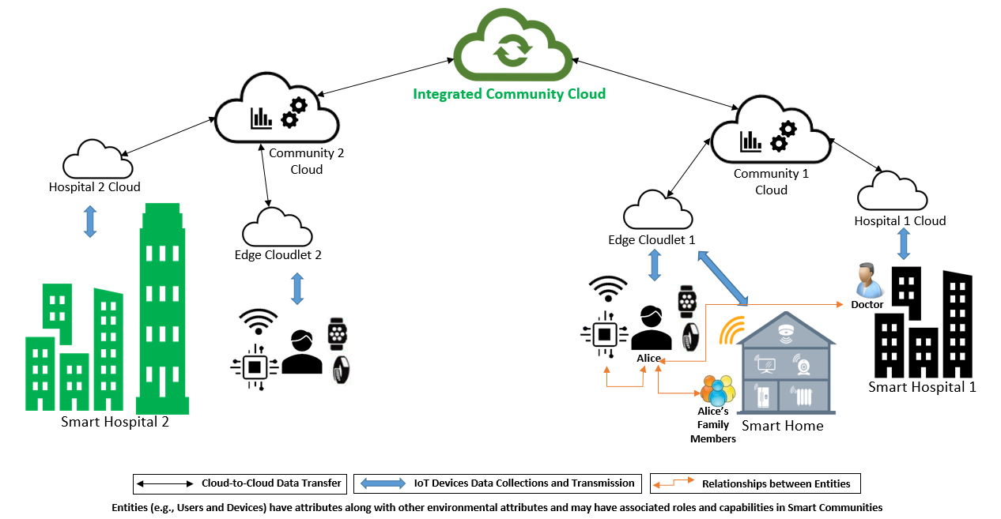
Smart Communities

Slide 24
Access Control Research Convergence
ABAC
ReBAC
RBAC
…
DAC
MAC
Convergent Access Control (CAC)
Access Control Policy Models
Access Control Enforcement Models
Application
Context

