Slide 1
Attribute-Based Access Control:
Insights and Challenges
Ravi Sandhu
Executive Director and Chief Scientist
Professor of Computer Science
Lutcher Brown Chair in Cyber Security
University of South Florida
April 4, 2018
ravi.sandhu@utsa.edu
www.ics.utsa.edu
www.cspecc.utsa.edu
www.profsandhu.com

Slide 2
ICS Mission and History
MISSION
Sustained excellence in graduate-level sponsored research
2007-2012
Founded by start-up funding from State of Texas
2012-2017
Graduated to a self-sustaining operation
2017-2022
Major expansion by winning NSF
C-SPECC grant
Situated in the College of Science, Department of Computer Science
Established world class laboratories for:
Secure cloud computing and
Malware research
In collaboration with:
College of Engineering
College of Business
College of Education
Open Cloud Institute
Cyber Center for Security & Analytics

Slide 3
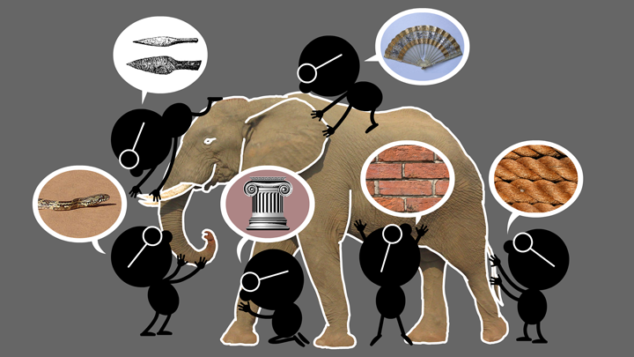

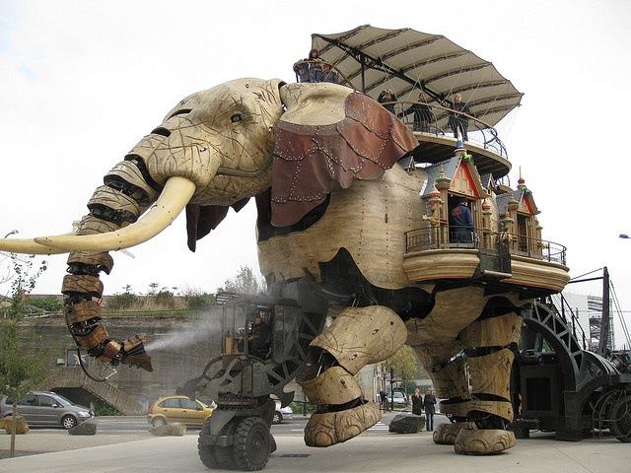


Natural vs Cyber Science
Elephant Problem
Cyber-Elephant Problem
The cyber-elephant problem requires Applied and Basic research Combined (ABC)
* The New ABCs of Research, Ben Schneiderman, 2016

Slide 4
ICS Major Research Areas
SECURITY TECHNOLOGIES
Access Control
Policy
Malware
Detection and Forensics
Security Dynamics
APPLICATION DOMAINS
Cloud Computing
Internet of Things (IoT)
Social Networks
Enterprise
Goal: Broaden and Deepen

Slide 5
Cyber Security Landscape
Objectives
POLICY
ATTACKS
Enable
What?
Why?
Respond
Enforce
Defend
PROTECT
How?
DETECT
Mechanisms
Complement

Slide 6
Cyber Security Landscape
Objectives
POLICY
ATTACKS
Enable
What?
Why?
Respond
Access
Control
Enforce
Defend
PROTECT
How?
DETECT
Mechanisms
Complement

Slide 7
Cyber Security Landscape
Objectives
POLICY
ATTACKS
Enable
What?
Why?
Respond
Access
Control
Enforce
Defend
PROTECT
How?
DETECT
Mechanisms
Complement

Slide 8
Access Control Evolution
Fixed policy
Discretionary Access Control (DAC), 1970
Mandatory Access Control (MAC), 1970
Role Based Access Control (RBAC), 1995
Attribute Based Access Control (ABAC), ????
Born 1990s
Flexible policy

Slide 9
ABAC Research Space
7. ABAC Design, Engineering and Applications
3. Administrative
ABAC Models
4. Extended
ABAC Models
5. ABAC Policy
Architectures and Languages
6. ABAC Enforcement Architectures
2. Core ABAC Models
1. Foundational Principles and Theory

Slide 10
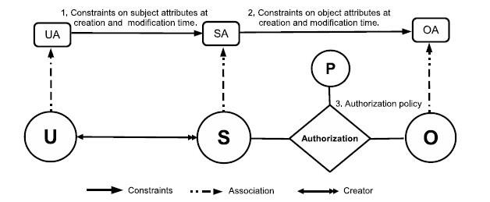
Core ABAC Models: ABAC_{α}
Can be configured to do simple forms of DAC, MAC, RBAC (Jin, Krishnan, Sandhu 2012)

Slide 11
Core ABAC Models: ABAC_{α}
Policy Configuration Points
Can be configured to do simple forms of DAC, MAC, RBAC (Jin, Krishnan, Sandhu 2012)

Slide 12
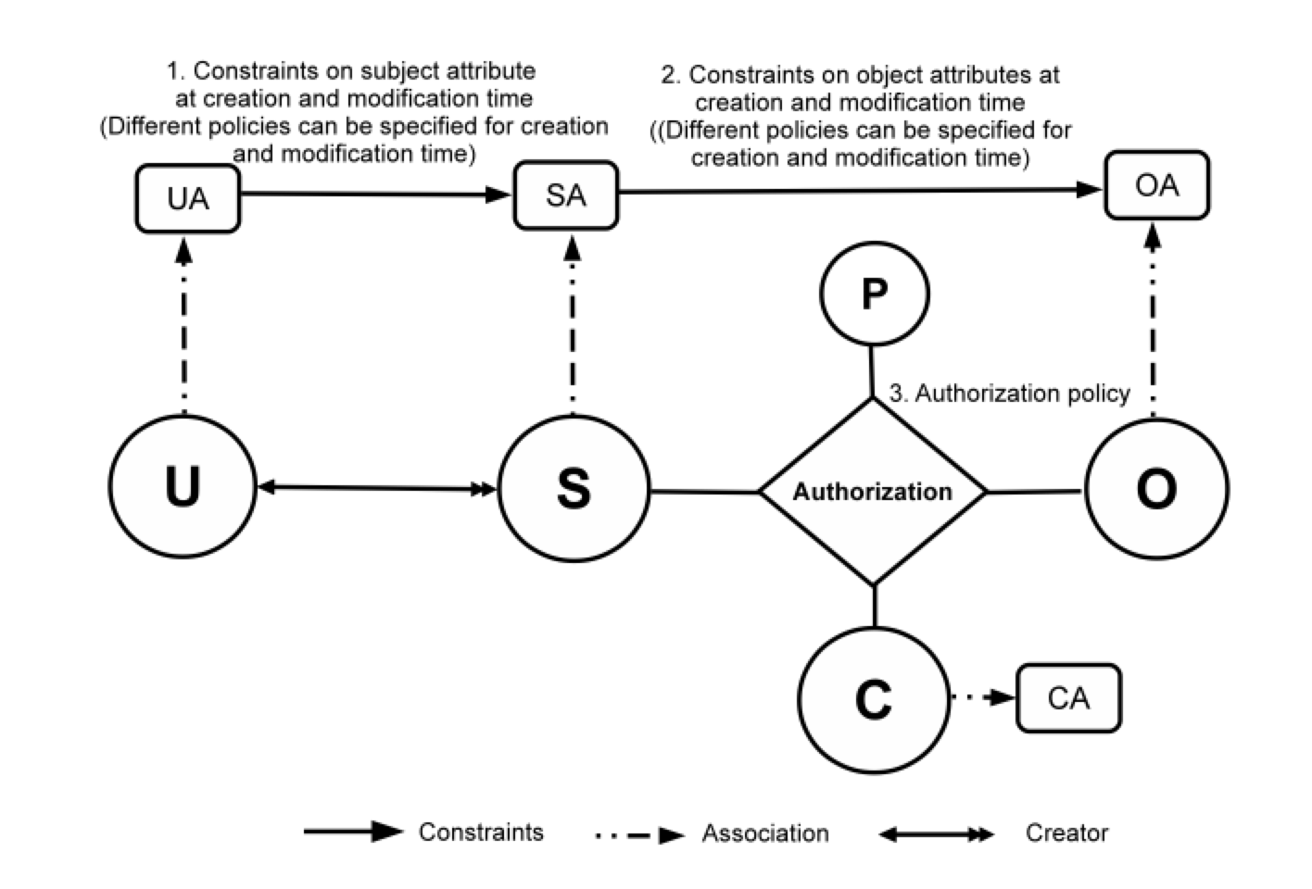
Core ABAC Models: ABAC_{β}
Can further be configured to do many
RBAC extensions (Jin, Krishnan, Sandhu 2014)

Slide 13
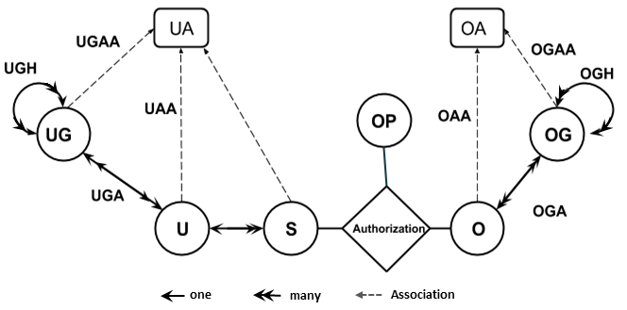
Administrative ABAC Models: HGABAC
Hierarchical Group and Attribute Based Access Control (HGABAC)
  Introduces User and Object Groups
  Simplifies administration of attributes
Servos and Osborn, 2015

Slide 14
ABAC Applications:
Cloud Enabled IoT
Alsheri, Bhatt, Patwa, Benson, Sandhu
2016 onwards

Slide 15
Policy Architecture:
Amazon AWS style

Slide 16
ABAC Research Space
*
7. ABAC Design, Engineering and Applications
*
3. Administrative
ABAC Models
4. Extended
ABAC Models
5. ABAC Policy
Architectures and Languages
*
6. ABAC Enforcement Architectures
2. Core ABAC Models
*
1. Foundational Principles and Theory

Slide 17
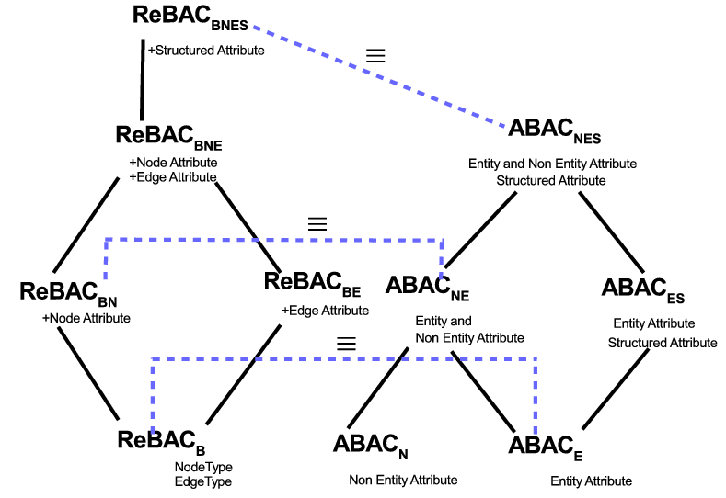
Extended ABAC Models: ReBAC versus ABAC
ReBAC and ABAC are not that different
(Tahmina, Sandhu 2017)

Slide 18
ABAC Enforcement Architecture: Federated ABAC
Fisher 2015
NCCOE, NIST, Building Block

Slide 19
Foundations: Safety Analysis
Discretionary Access Control (DAC), 1970
Mandatory Access Control (MAC), 1970
Can subject s obtain a right r on object o?
Current state?
Some future state?
Role Based Access Control (RBAC), 1995
Safety
Complexity
Attribute Based Access Control (ABAC), ????
Ahmed, Rajkumar, Sandhu
2016 onwards

